Slide 1

Project Title - Seasonal Agriculture Performance Analysis
Student Name : Anjana Ajithkumar Pillai
College Name : Amrita Vishwa Vidyapeetham
AICTE STU ID : STU694b66590a7151766549081

Slide 2

PROBLEM STATEMENT
Agricultural activities are influenced by seasonal variations in environmental conditions, farming practices, resource availability and market conditions. As a result, agricultural performance may differ from one season to another. However, raw agricultural data does not clearly explain how agricultural performance changes across seasons or what patterns can be observed in different seasonal conditions. The problem is to analyze the given agricultural dataset and investigate seasonal differences in agricultural performance by identifying meaningful patterns, trends, relationships and variations within the available data.

Slide 3
PROJECT DESCRIPTION
The Seasonal Agriculture Performance Analysis project evaluates how agricultural productivity, resource utilization, environmental factors, and economic returns vary across the three primary Indian crop seasons: Kharif, Rabi, and Zaid. While agricultural output fluctuates due to changing weather patterns, resource constraints, and soil health, raw farming data often masks underlying operational inefficiencies. This project applies exploratory data analytics, comparative metrics, and data visualization to uncover critical seasonal trends, evaluate water and input efficiency, and deliver actionable insights for evidence-based agricultural planning and risk mitigation.

Slide 4

WHO ARE THE END USERS?
Farmers & Farm Managers: For selecting suitable crops per season, scheduling irrigation, and cutting input costs.
Agricultural Extension Officers: For delivering targeted, seasonal guidance on pest control and soil nutrients.
Government & Policymakers: For planning regional water allocation, fertilizer subsidies, and seasonal farm schemes.
Agritech & Advisory Platforms: For powering data-driven recommendations and predictive farming apps.
Agri-Lenders & Crop Insurers: For evaluating seasonal yield risks and setting credit or insurance policies.

Slide 5

TECHNOLOGY USED
Language: Python
Platform: Google Colab
Data Processing: Pandas, NumPy
Data Visualization: Seaborn, Matplotlib
Version Control: Git & GitHub

Slide 6
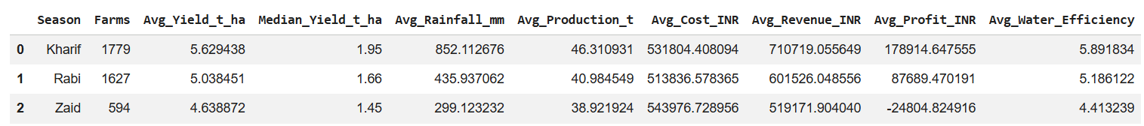
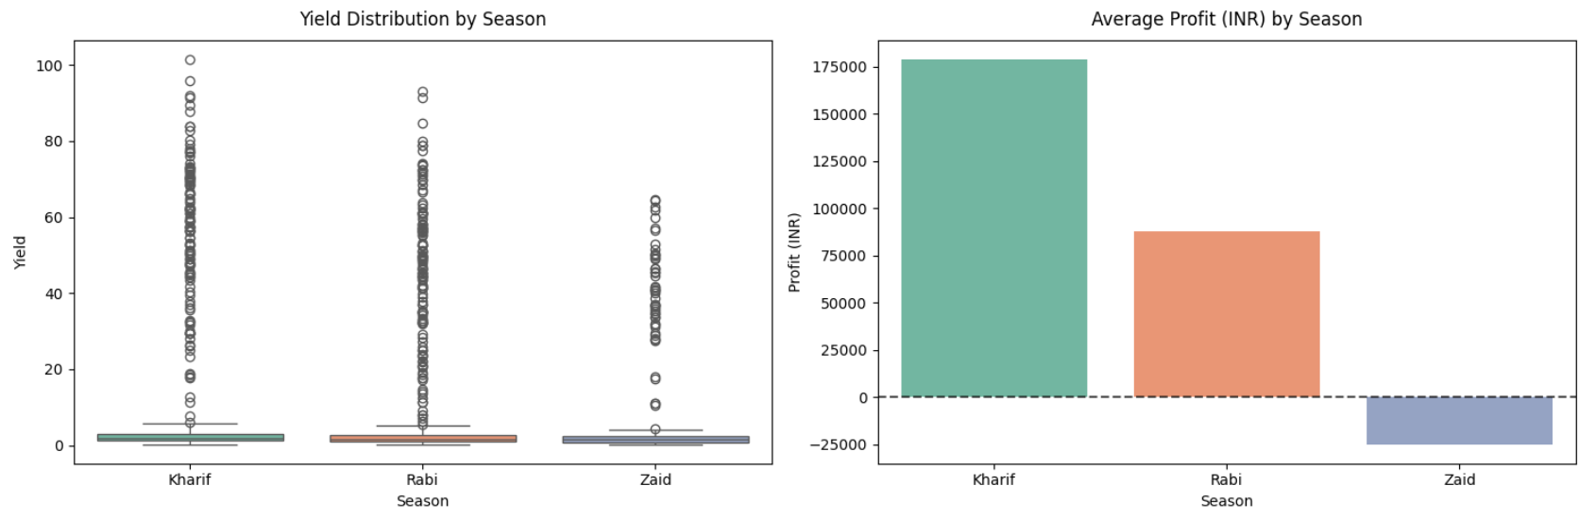
RESULTS
Seasonal Performance Aggregations
Seasonal Comparison: Crop Yield Spread vs. Net Profitability

Slide 7
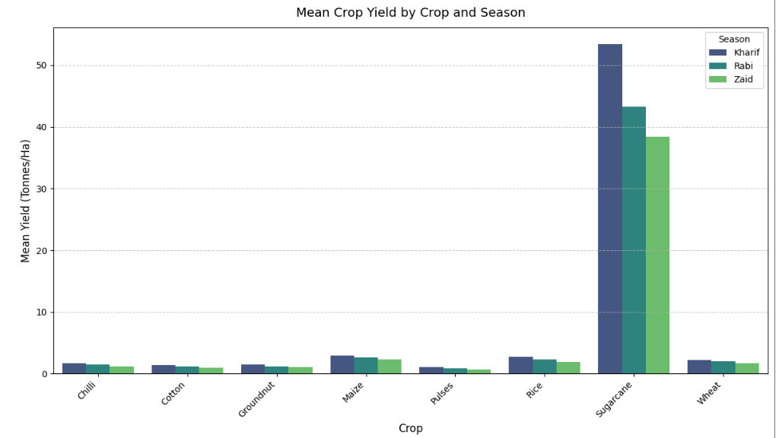
RESULTS
Crop-Wise Productivity Comparison Across Farming Seasons

Slide 8
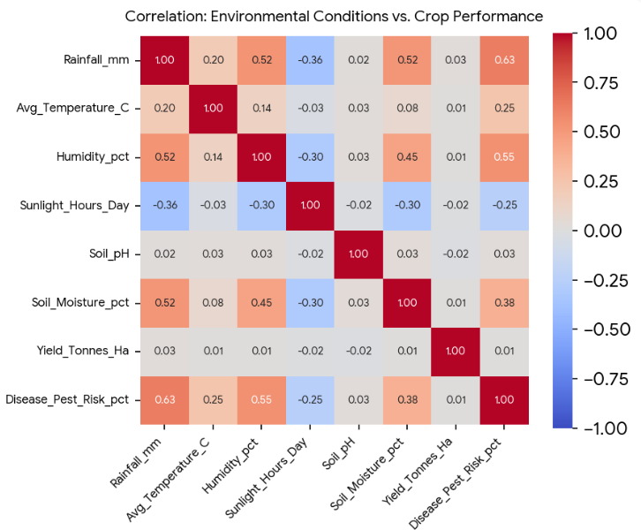
RESULTS
Impact of Environmental Factors on Crop Yield & Pest Vulnerability

Slide 9
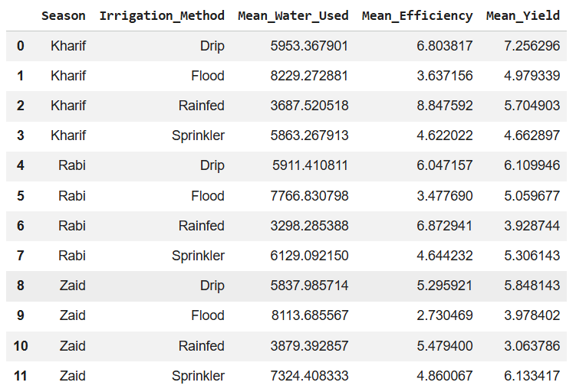
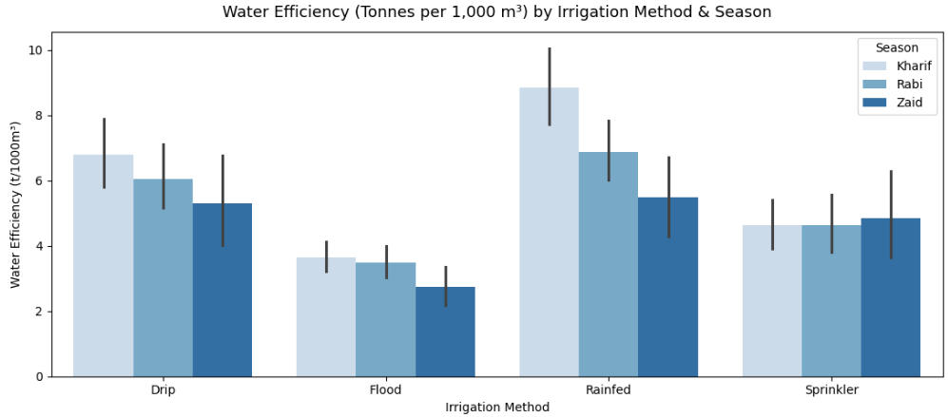
RESULTS
Irrigation Method Impact: Water Usage & Efficiency Across Seasons

Slide 10
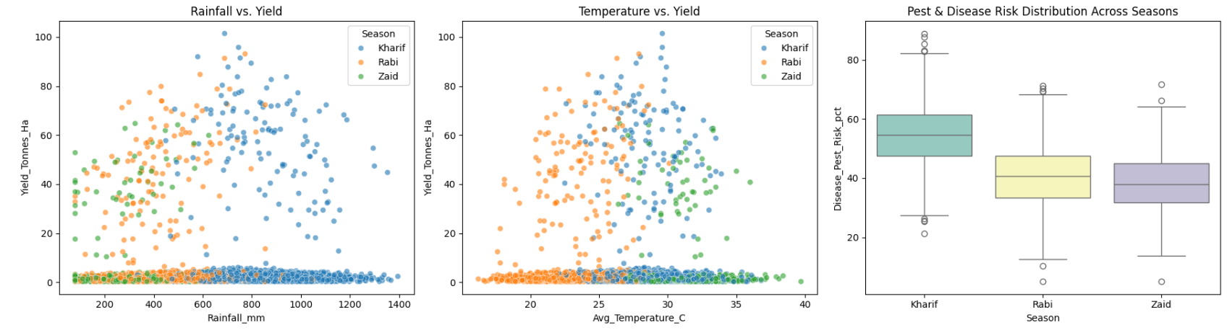
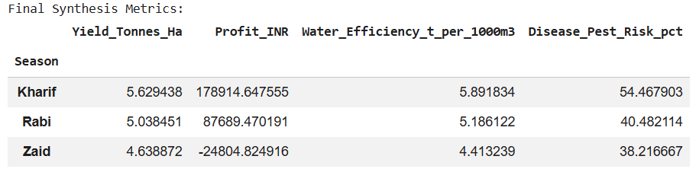
RESULTS
Influence of Climate Factors & Pest Risk on Seasonal Performance
Core Seasonal Agricultural & Operational KPIs

Slide 11
FUTURE SCOPE
ML Yield Forecasting: Deploy predictive models (XGBoost/Random Forest) to forecast seasonal crop yield and revenue.
IoT & Satellite Integration: Connect live weather stations and satellite imagery for real-time soil and moisture monitoring.
Smart Irrigation Scheduling: Automate drip and sprinkler timing using real-time weather and evapotranspiration data.
Early Pest Warning System: Trigger automated alerts when rainfall and humidity hit disease thresholds.
Web & Mobile App Deployment: Package insights into an interactive Streamlit dashboard for farmers and extension officers.

Slide 12
GitHub Link
https://github.com/Anjana-0404/Seasonal-Agriculture-Performance-Analysis/tree/main

Slide 13

VOIS Course completion certificate -
Course name- Data Visualization

Slide 14
Thank you
.
.

